Slide 1
Combined Local Elections - 4 May 2023 Candidates and Agents Briefing
Thursday, 6 April 2023

Slide 2
Rob Hadgett
Accredited Fraud Investigator
Election Malpractice SPOC
& Financial Investigation Unit

Slide 3
Introduction
Matt Powis
Elections and Executive Support Manager
Notes:
Over the next few slides, I will be updating you on what has happened since close of nominations on Tuesday, a look at the timetable and take you through the verification and the count.

Slide 4
Summary of what has been contested
District:
All 20 areas are contested.
Parish:
7 ward areas are contested Codsall North, Codsall South, Featherstone Ward, Great Wyrley North, Perton Lakeside, Wombourne North and Wombourne South.
Notes:
So what does that mean in terms of ballot papers.
So there are 2 different combinations of what will be happening across the District.
As all 20 District areas are contested, the 7 Parish Wards will be combined with the District so the electors will receive 2 ballot papers. They will be issued with the District paper first and then the Parish paper. This is to avoid cross contamination with the ballot boxes. An example of this would be Codsall District and Codsall North Parish Ward.
Where the District is standalone, electors will receive the one ballot paper.
Just a reminder that the district papers will be printed on aqua and the parish ballot papers printed on white.

Slide 5
So what happens after nominations close
Statement of Persons Nominated Notices, Uncontested Notices & Notice of Elections Agents.
Absent Voting – 1st batch sent out around 14th April (1st Class), 2nd batch sent out around the 21st April.
Training.
Polling Station paperwork.
Verification and Count paperwork.
Notes:
So the statement of persons nominated, uncontested notices and notice of election agents was published on our website, social media, we sent it to Parish clerks to display in their noticeboards and outside the Council Offices. These were published after much checking and rechecking!
All 27 ballot papers have now been signed off with our printers and the main batch of Absent Votes will be sent out around the 14th April. They will be going out first class. The deadline for PV applications is the 18 April at 5.00p.m. so a smaller 2nd batch sent out around the 21st April to capture any new applications.
Training – On 19th and 20th April we will be training all our Poll Clerks and Presiding Officers using an online training portal and live training sessions.
We are again printing all the District election paperwork off in Aqua and the Parish in White.
We have also started working on producing all the verification and count paperwork which as you can imagine is a huge amount of paperwork that needs to be co-ordinated.

Slide 6
Timetable
Last Date for Registration | Midnight – 17 April 2023
Receipt of Postal Vote Applications | 5pm – 18 April 2023
Publication of Notice of Poll | 25 April 2023
Receipt of Proxy Vote Applications | 5pm – 25 April 2023
Deadline for applications for a Voter Authority Certificate or Anonymous Elector’s Document | 5pm – 25 April 2023
Deadline Appointment of Verification and guests and Postal Voting Agents | 26 April 2023
Appointment of Poll and Count Agents | 26 April 2023
First Day to Issue Replacement Lost Postal Ballot Papers | 27/04/2023
Receipt of Emergency Proxy Vote Applications | 5:00 pm 04 May 2023
Last Day to Issue Replacement Spoilt or Lost Postal Ballot Papers | 5:00 pm 04 May 2023
Day of Poll | 7:00 am to 10:00 pm 04 May 2023
Return of Election Expenses – Parish | 1 June 2023
Return of Election Expenses – District | 9 June2023
Notes:
A brief reminder of the timetable is shown on the slide.
The last day to register to vote on the 4th May is this 17 April and then new PV applications need to reach us by 5pm 18 April 2023.
The key on this slide for you is the items highlighted in red.
Deadline Appointment of Verification and guests and Postal Voting Agents – 26 April 2023
Appointment notice of Poll and Count Agents – 27 April 2023

Slide 7
Postal Voting
Opening process.
1st Opening session – Thursday 27 April – 10:00 – 16:00.
Opening times update on our website.
Last session – Thursday 4 May – 20:00 – finish.
Postal Voting Agents.
Notes:
Just to provide you with some information on the process.
All return envelopes back to use include the ward which they are for.
If a District and Parish area is combined then the ballot paper pack will include both ballot papers and the District seat will be highlighted on the front of the envelope to assist us when we receive it back in. We will then check that the correct DOB and signature matches our records. If it matches, the ballot papers will then be opened from the envelope A and then stored in the Ballot Box ready to be taken to the Count.
The 1st session will be on the 27th April and normally dependent on turnout, the first few days are busy. We will keep our website updated if we need to amend any of our sessions.
Candidates and Agents are entitled to attend any session and can appoint Postal Vote agents. If you can come and let me know what ward it is that you are interested in, if we haven't already opened that ward then we will do our best to open what you are interested in. All ballot papers will be kept face down.

Slide 8
Polling Day
List of polling stations.
PSI’s.
Contact Centre helpline – 01902 696121 .
Elections Office.
Notes:
A list of our polling stations, can be found on our website. 81 in total.
We will have 8 Polling Station Inspectors that will be visiting a set round of Polling Stations at least twice during the day and will have a base at one. PSIs additional resource in case of issue arising at any of the stations. Can adjudicate if issues arise such as with tellers etc. Candidates and agents are encouraged to read EC guidance on behaviour at polling stations which is available on their website.
For any elector queries you receive, please provide them with the helpline number 01902 696121 that will be manned from 6:30am.
The Elections Office will also be open from 6:30am in case you have any queries.

Slide 9
Verification
Perton Civic Centre, Church Road, Perton Wolverhampton WV6 7PD
5th May, commences at 8.30a.m – finish.
Candidates and Agents can arrive from 8.00am and wait in the designated Candidate and Agent room.
Verification Process.
Verification Statements and turn out.
Notes:
The Ballot Boxes will be receipted at Codsall Community Hub (Council Offices) where they will be stored overnight securely. Verification will then take place at Perton Civic Centre as we have used this venue previously.
The Ballot Boxes will be checked in at the Council Offices. Certain checks are carried out before the Presiding Officer is allowed to leave for example checking that the Ballot Paper Account is correct.
Early on Friday, 5 May, the boxes are transported securely to Perton Civic Centre then brought into the Hall by dedicated staff, allocated and then distributed to the correct, pre allocated table.
In essence all we are doing during the verification stage is checking that the ballot papers in the box matches what is on the ballot paper account. There will be a separate team that will be opening all the unused sacks up in the ballot box receipting room to provide an additional check.
The Returning Officer will be providing updates on what each table are verifying and when they process has been completed. For each ward that has been verified the ballot papers, will be sealed away in a clear container and the seals captured.
All verification statements will be posted on the noticeboards as we go through the day which will include the turnout as well.
We will arrange for security to stay with the ballot boxes during the night.

Slide 10
Notes:
6 Tables
2 Zone Supervisors
Verification boards will be in the Candidate and Agent Rooms
Candidate and Agents can walk round the outside only.
The totem polls will contain information what is being dealt with at that table.

Slide 11
The Count
5th May
Perton Civic Centre, Church Road, Perton Wolverhampton WV6 7PD
Perton has a number of amenities including local shops and Sainsburys.
Candidates and Agents can arrive from 8:00am and wait in the Candidate and Agent room.
Start at the verification 8.30a.m
Notes:
The Count will take place the same day.
Candidates and Agents can arrive from 8:00am and wait in the Candidate and Agent room.
There will be tea and coffee facilities available for you to make a drink but no drinks will be allowed in the actual count room.
We will be starting the Count with the smaller Parish and District seats and you will know in advance which tables will be dealing with each area. More details on this will follow over the next couple of weeks as plans are finalised.
We are unable to predict any timings for the day at this stage.
We recognise that comms are important both before and during the verification and count; we will ensure we keep candidates/agents aware of timings as best as we can – we have a designated comms officer present on day for that.
As using Perton, slightly smaller venue than previously used so both timing of access into the hall and numbers will be critical. Looking to work with candidates and agents to facilitate a smooth, transparent process. Suggesting text messages to Agents for notification of wards being counted.
Due to the complex nature of counting multi member vacancies, I wanted to run through now how we will approach the counting.

Slide 12
Block Voting
Candidate 1 | Yellow Party
CANDIDATE 2 | Red Party
CANDIDATE 3 | Pink Party | X
CANDIDATE 4 | Yellow Party
CANDIDATE 5 | Red Party
CANDIDATE 6 | Purple Party
CANDIDATE 7 | White Party
CANDIDATE 8 | Pink Party | X
CANDIDATE 9 | Pink Party | X
CANDIDATE 10 | Red Party
Candidate 1 | Yellow Party
CANDIDATE 2 | Red Party | X
CANDIDATE 3 | Pink Party
CANDIDATE 4 | Yellow Party
CANDIDATE 5 | Red Party | X
CANDIDATE 6 | Purple Party
CANDIDATE 7 | White Party
CANDIDATE 8 | Pink Party
CANDIDATE 9 | Pink Party
CANDIDATE 10 | Red Party | X
There is often a pattern of voting along political party lines.
Used where the voter used all votes.
Counters, supplied with templates for each likely pattern, sort ballot papers accordingly, count them and allocate the number of votes to each candidate in that pile.
The ‘non-conforming’ ballot papers are then dealt with by another means.
Notes:
There is often a pattern of voting along political party lines. Used where the voter used all votes. As you can see on the example on the left the elector has chosen all the pink party so that would go in the pink party basket and then the example on the right would go in the red party basket.
The ‘non-conforming’ ballot papers are then dealt with by another mean which ill talk about on the next slide. (Grass Skirts)
Block voting will work for the District seats but not for the Parish seats as a large proportion has either independent candidate or the description has been left blank.
So the first process is for the Head Counters to commence sorting. Counters, supplied with templates for each likely pattern, sort ballot papers accordingly, count them and allocate the number of votes to each candidate in that pile. They will have baskets labelled for each party, a doubtful tray and a tray called others.
So once we have a final total for the block voting, we can then move onto the grass skirts element.

Slide 13
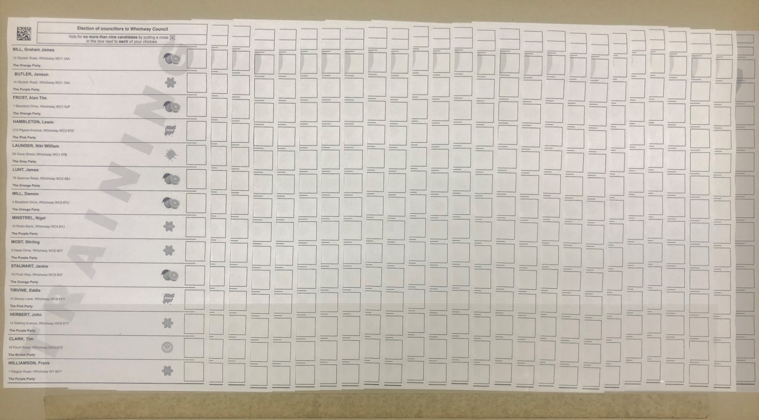
The Count – Counting Board/Grass Skirts
- Mixed votes.
- 25 ballot papers with a coloured count control sheet at the end.
Notes:
So once the block voting ballot papers and doubtful papers have been dealt with.
The remaining ballot papers are then grass skirted on our counting board.
The first thing you do is add a coloured control sheet to the far right and then fit 25 ballot papers under the clear plastic.
The counters then go across and add in the end column the number of votes and then work down vertical to work out if there are any votes that haven't been used.
This is an essential part of the process so we can ensure that we balance back to the number that we have had verification.
So if we had 10 ballot papers with 4 vacant seats, we know that we needed to come back to 40 votes.
Declaration
Once we are happy with the result
Provisional result shared with Candidates and Agents
The Returning Officer makes the declaration public.

Slide 14
Questions?
elections@sstaffs.gov.uk
01902 696121

